Slide 1

BANK MANAGEMENT APPLICATION
-By Abhinay Dhakne (194554)

Slide 2

Problem Statement
Create a bank system where you can store the customer details. Given are the conditions to Deposited Money, Withdraw Money, check the balance and display the final balance, display the list of customers of the bank with the final balance is search by Account no. Use case and switch, collection to store the customer details and transaction details.
Minimum balance should Rs.1000

Slide 3
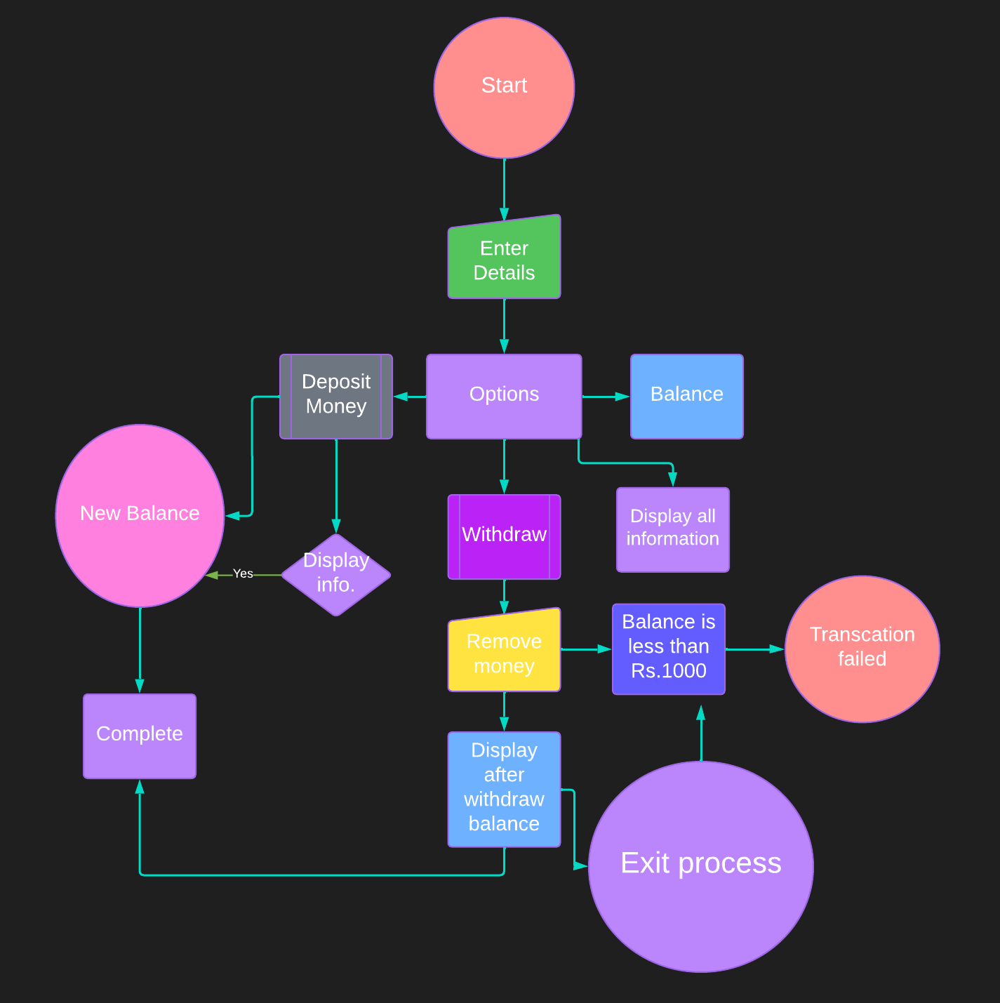
Flowchart

Slide 4

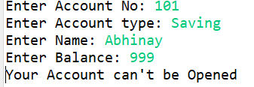
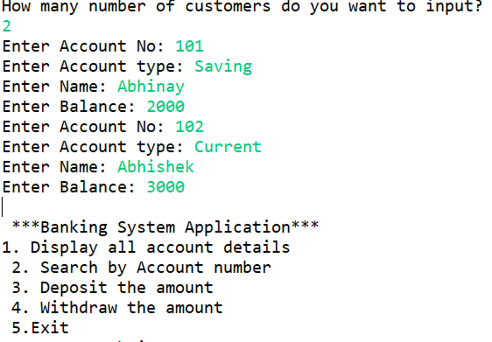
Let's See Code Part
Opening of the Account

Slide 5
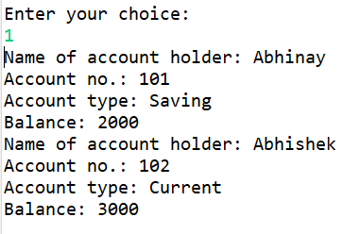
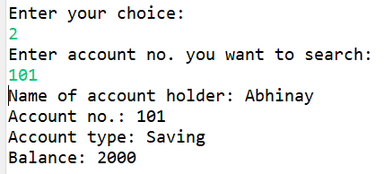
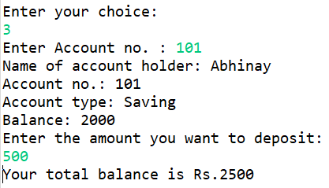
After creating of Account

Slide 6
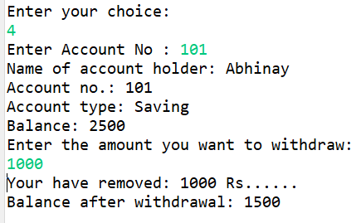
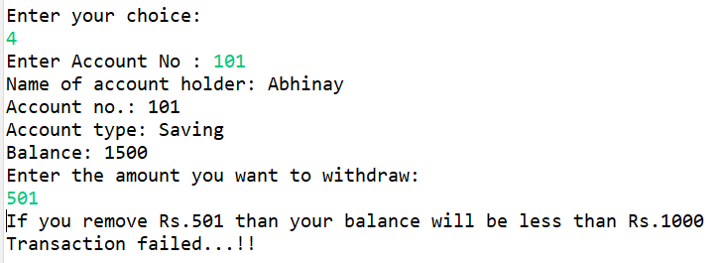
Withdraw Process

Slide 7
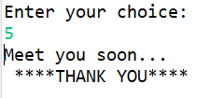
End of the process

Slide 8

Thank You

